Slide 1
Reducing risk of investment in Bitcoin and Gold
By: Bubba Ernest, Rosie Dabbaghi, Kaushik Basavaraju

Slide 2
Motivation and Summary:
In this project, our goal is to predict Gold and Bitcoin (Crypto Gold) price for a 30-day testing period. The reason we chose these two types of assets is that Bitcoin is a investment opportunity, but it is very volatile and some investors don't feel comfortable investing in it. We are trying to find the entry and exit point for Bitcoin and Gold, so when Bitcoin is in decline, we will exit the position and invest the money in Gold which is much less volatile but has some potential for growth. We hope by this technique, we will increase the return of the investment and reduce the risk of investing in bitcoin and make it a more favorable investment for risk averse investors. We will be using machine learning techniques Time Series to predict the future price of Bitcoin and Gold in next 30 days and Algorithmic trading to find out entry and exit point to switch between Bitcoin and Gold.
The data for this analysis are Bitcoin and Gold historical closing prices between 1/1/2015 and 5/31/2023 which was downloaded from Yahoo Finance. We predicted the price for both between 6/1/2023 to 6/30/2023.

Slide 3
Questions and Data:
Our main questions were:
Can we find entry and exit points for Bitcoin and Gold based on historical closing price
Can we reduce the risk of investment in Bitcoin by exiting the position and entering in Gold using signals
Can we increase investment return by switching between Bitcoin and Gold using our model signals
We will be using machine learning technique Time Series to predict the future price of Bitcoin and Gold in next 30 days and Algorithmic trading to find out entry and exit point to switch between Bitcoin and Gold.
The data for this analysis Bitcoin and Gold Closing price between 1/1/2015 and 5/31/2023 was downloaded from Yahoo Finance. We predicted the price for both between 6/1/2023 to 6/30/2023.

Slide 4
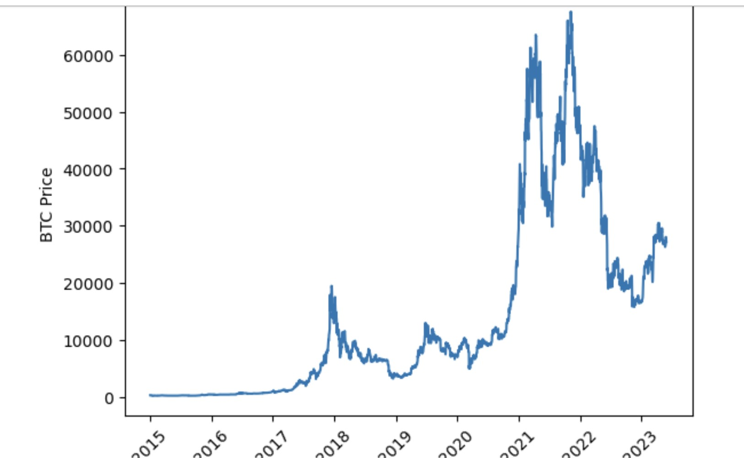

Slide 5
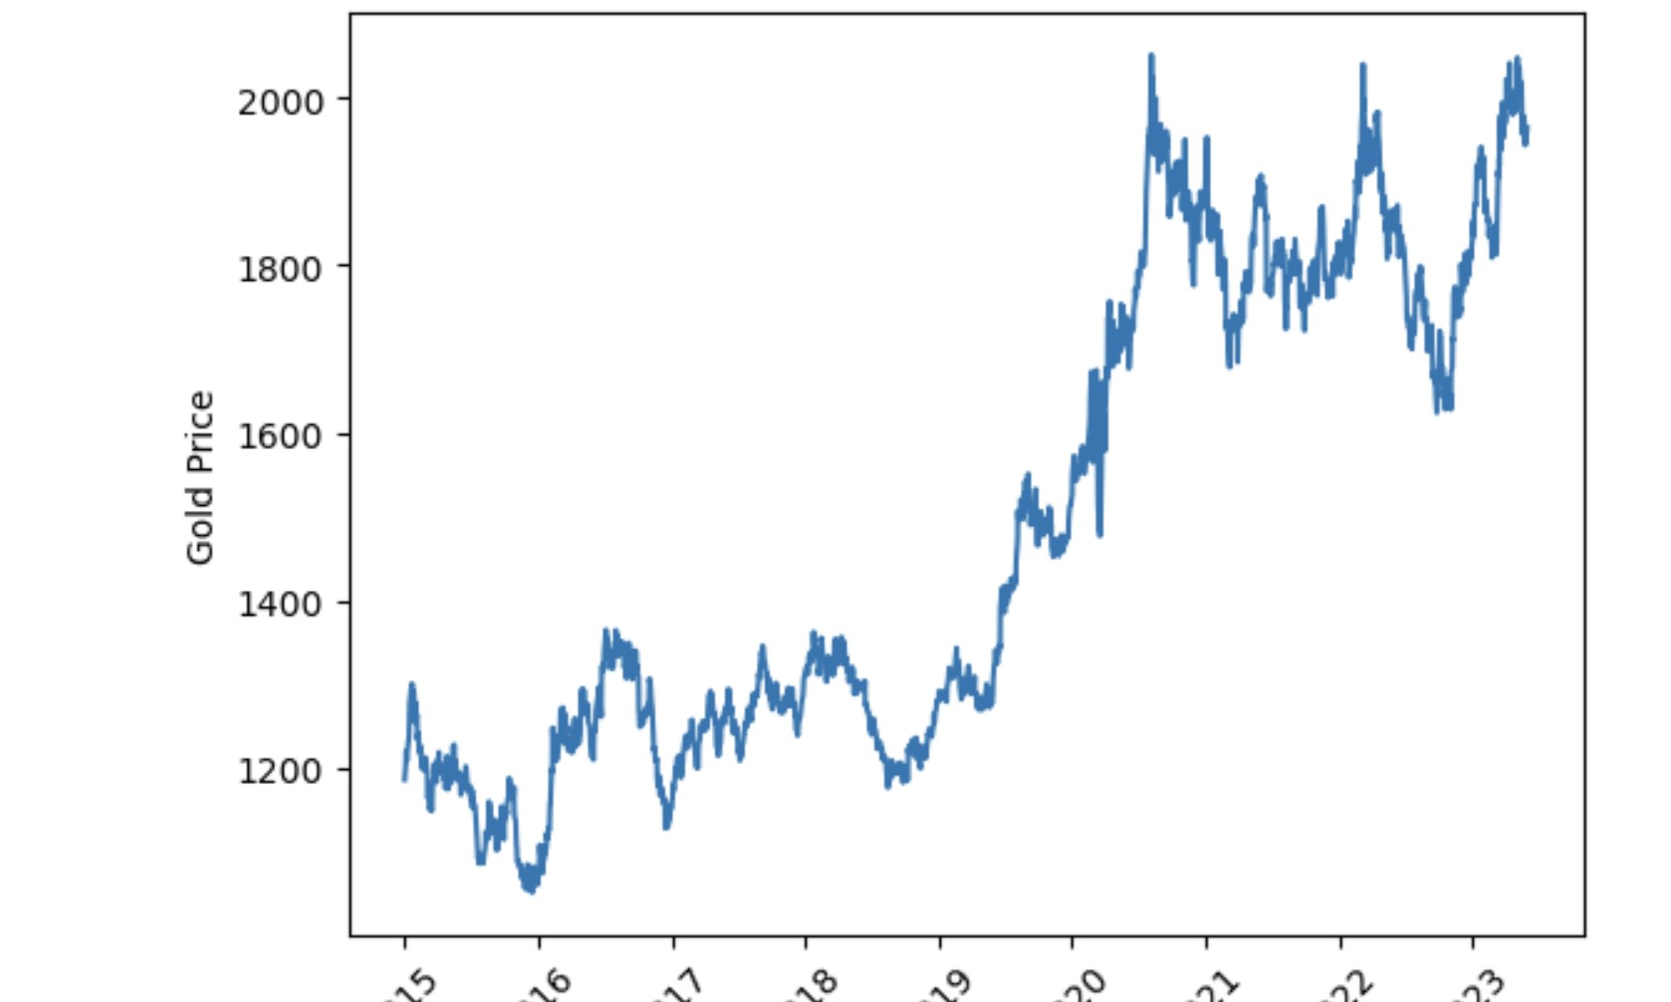

Slide 6
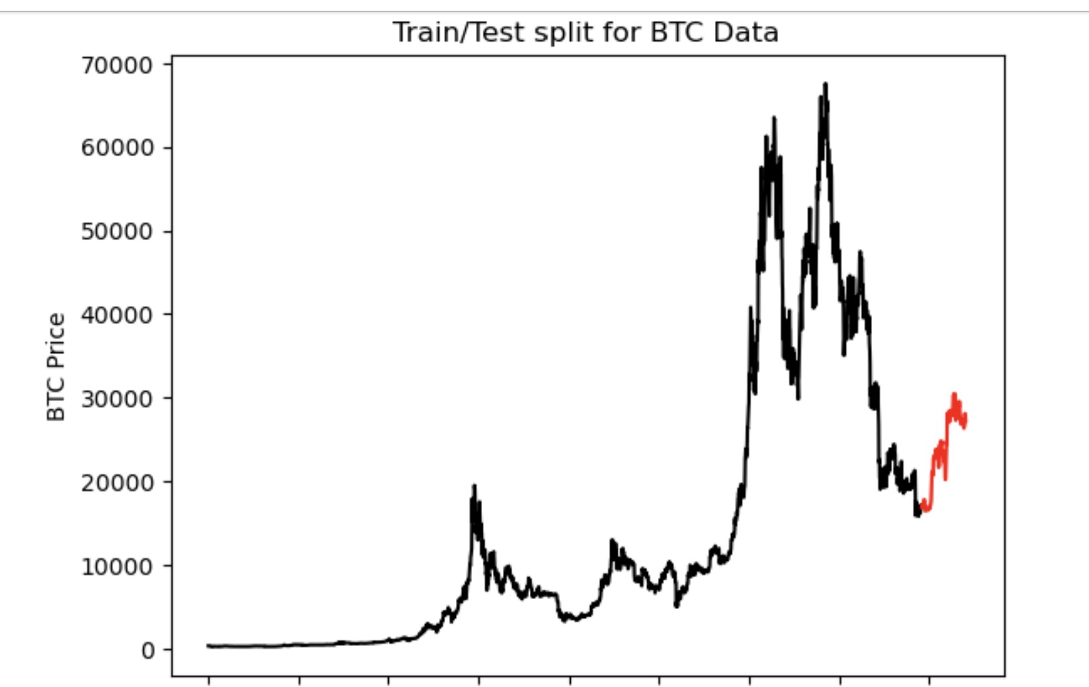

Slide 7
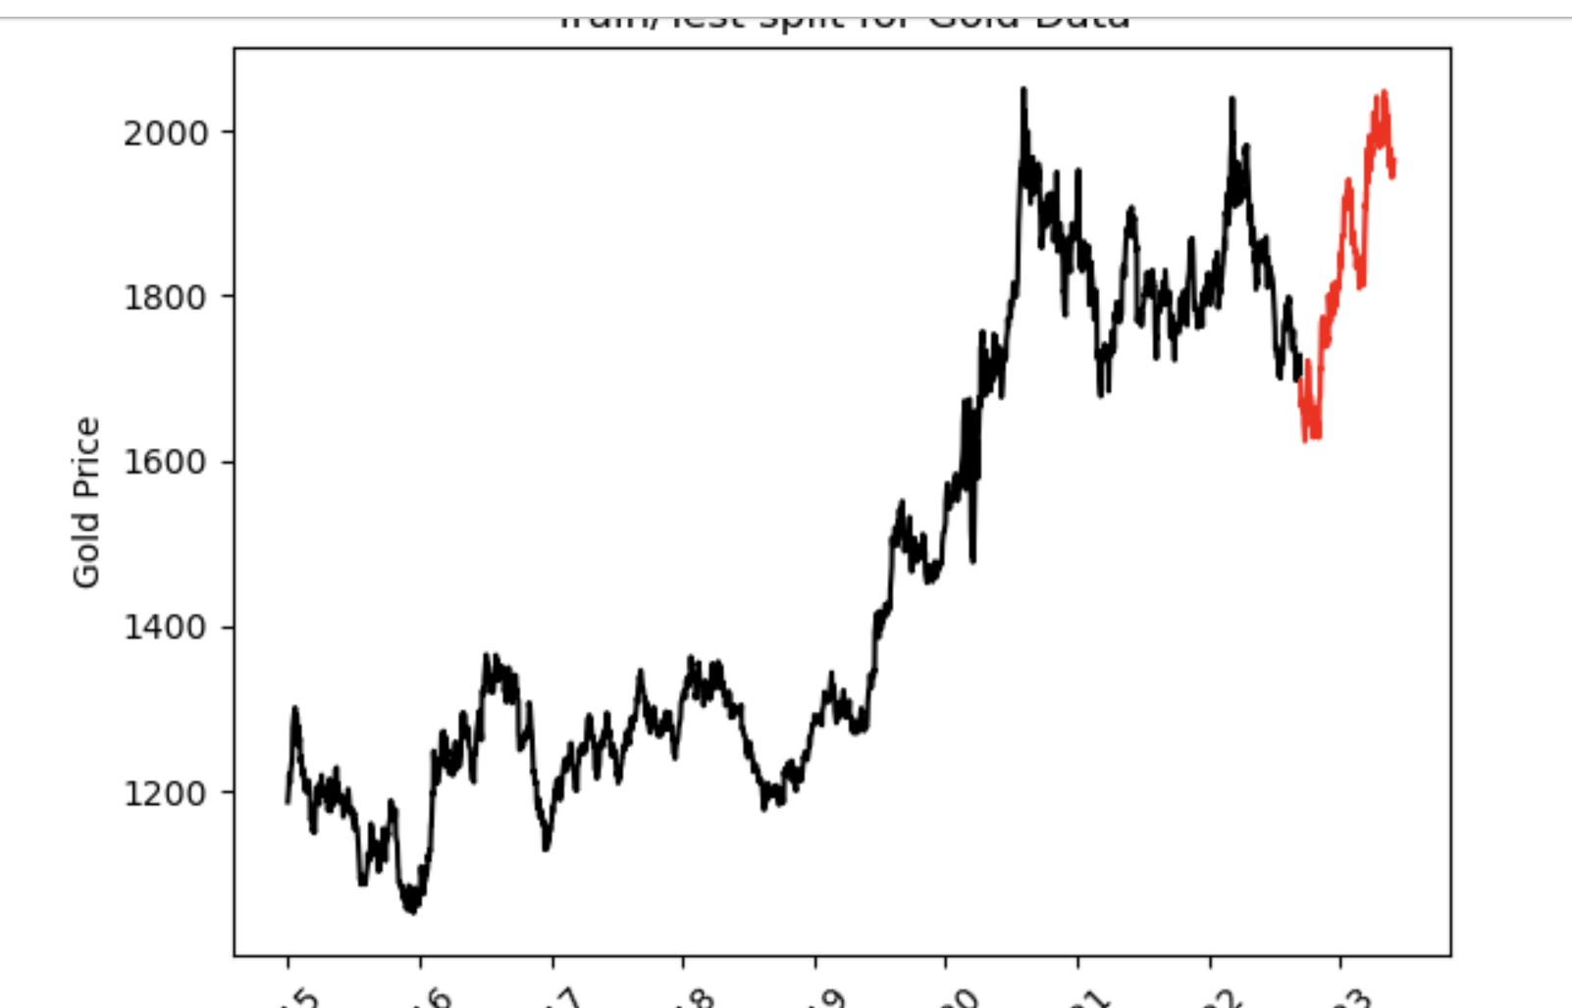

Slide 8
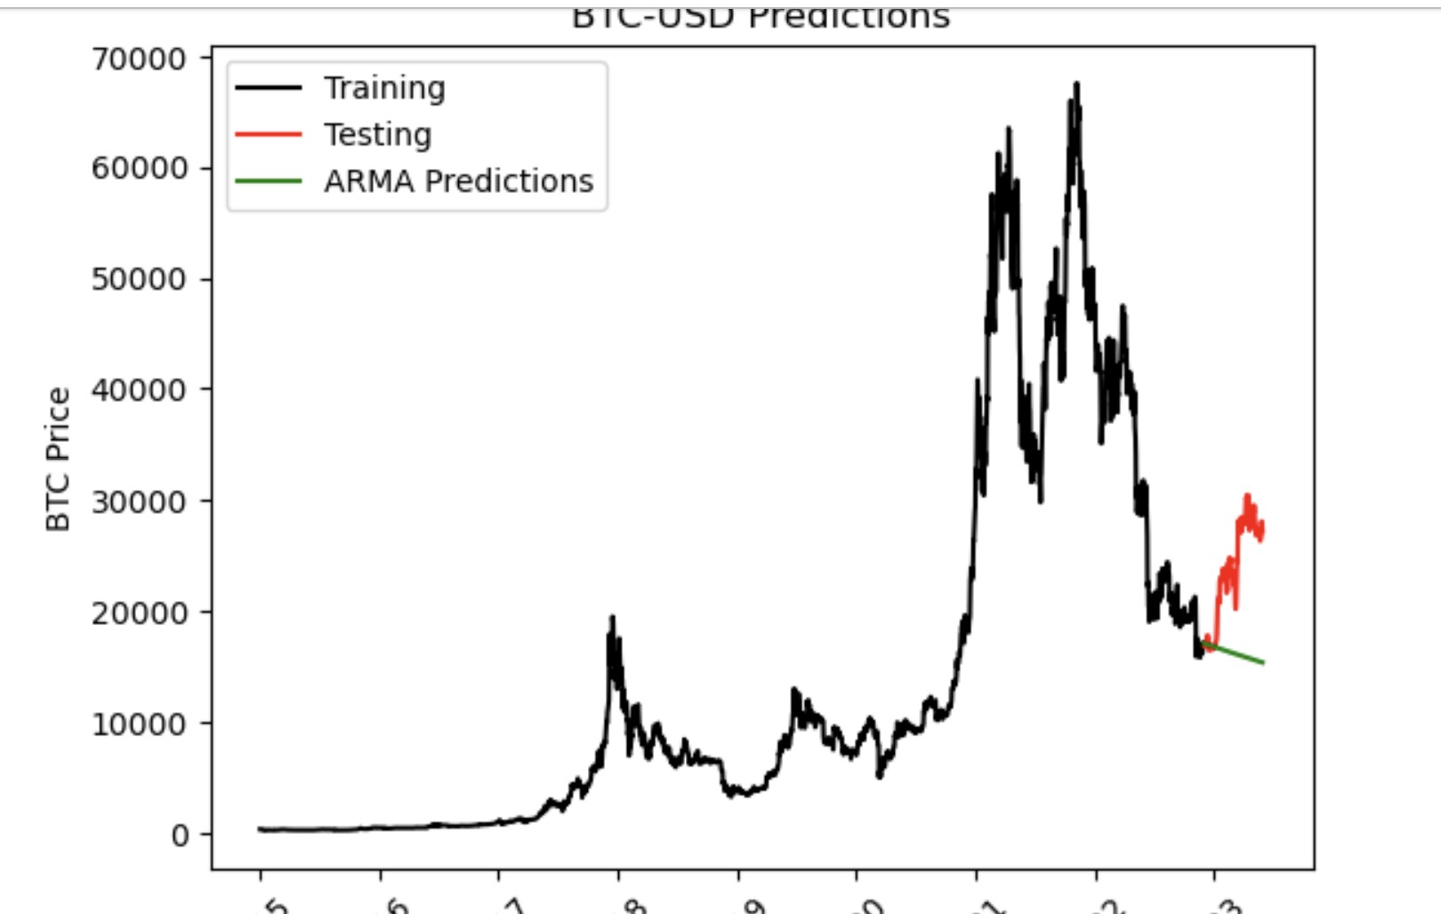

Slide 9
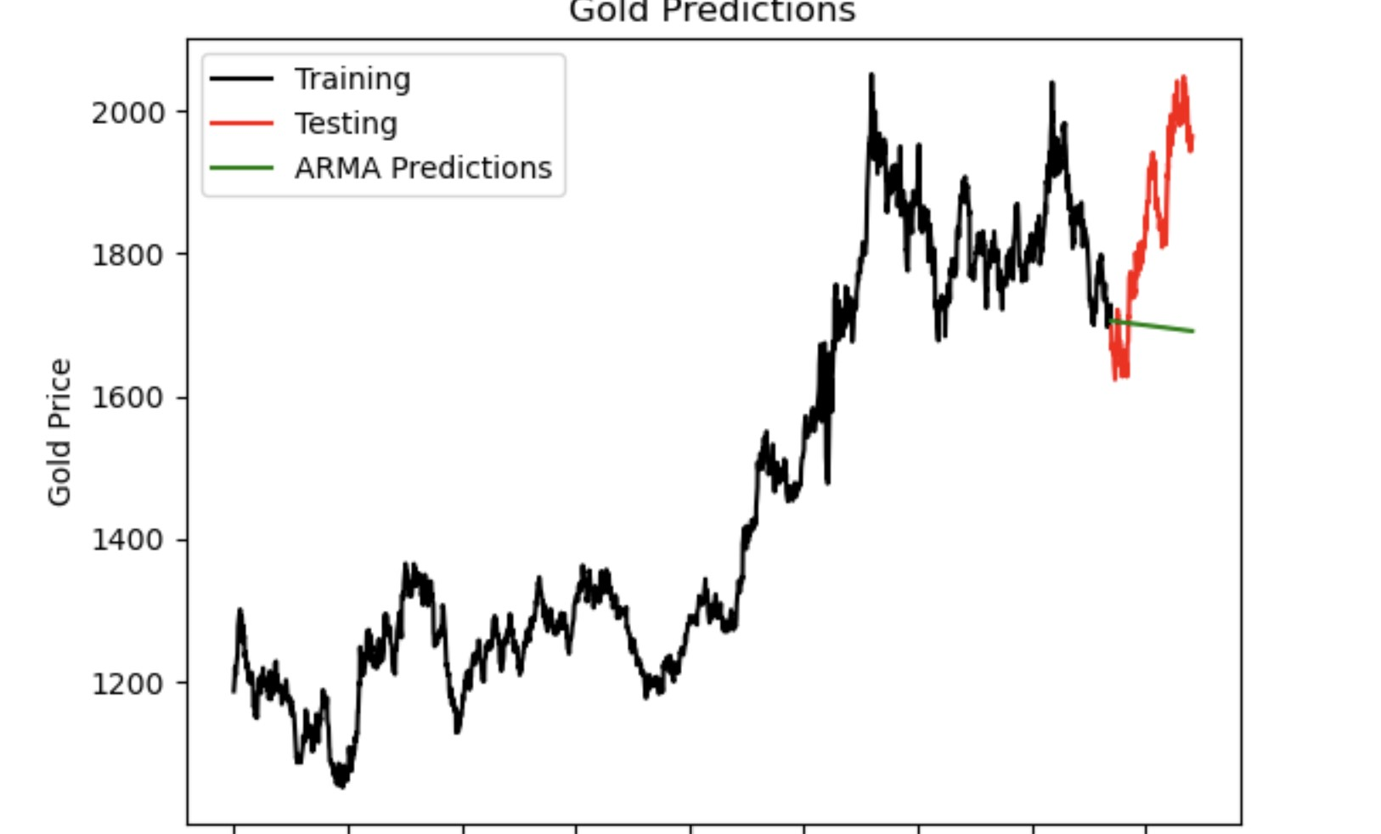

Slide 10
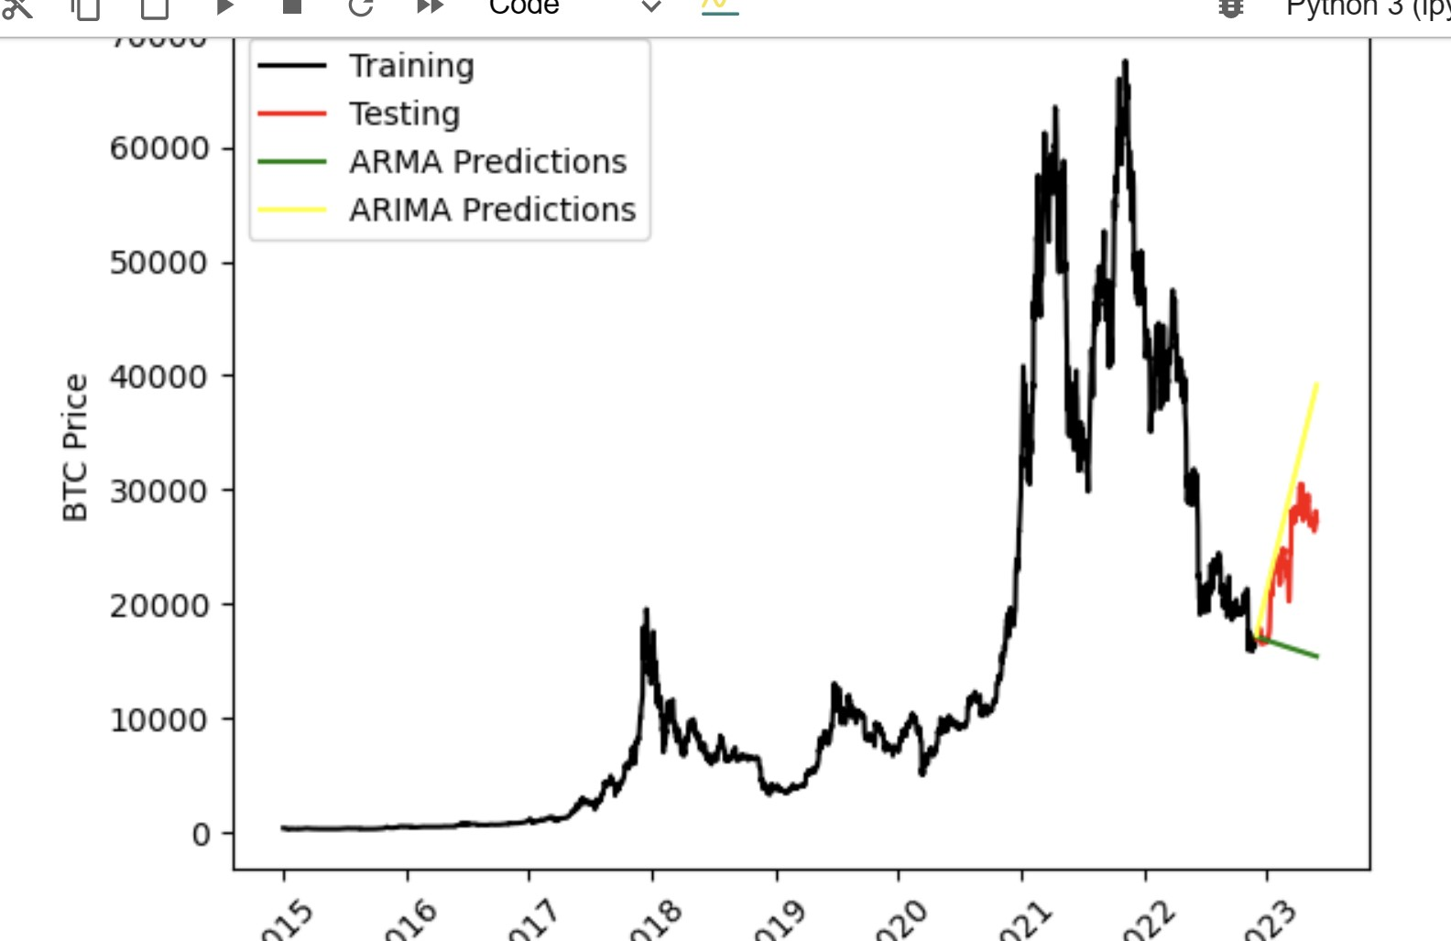

Slide 11
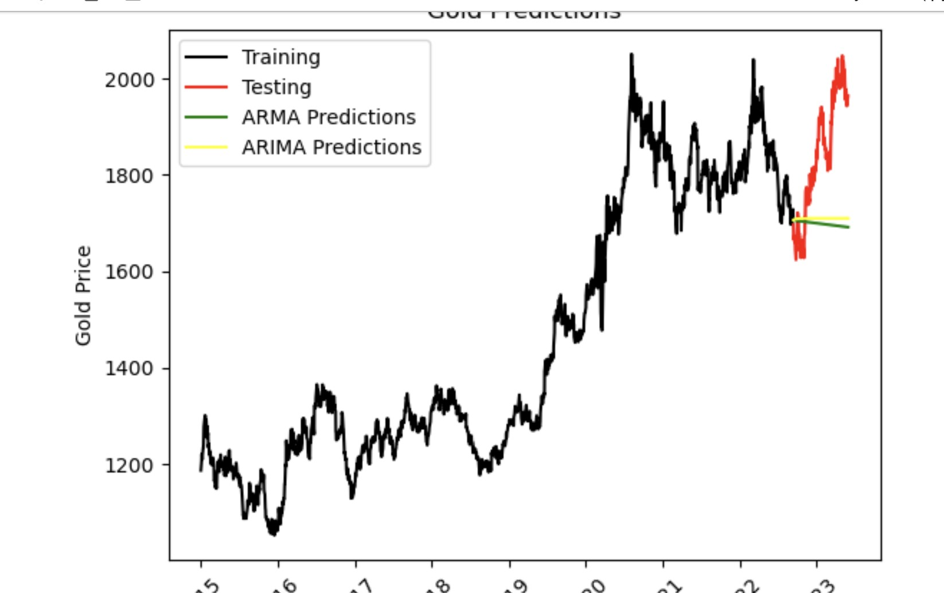

Slide 12
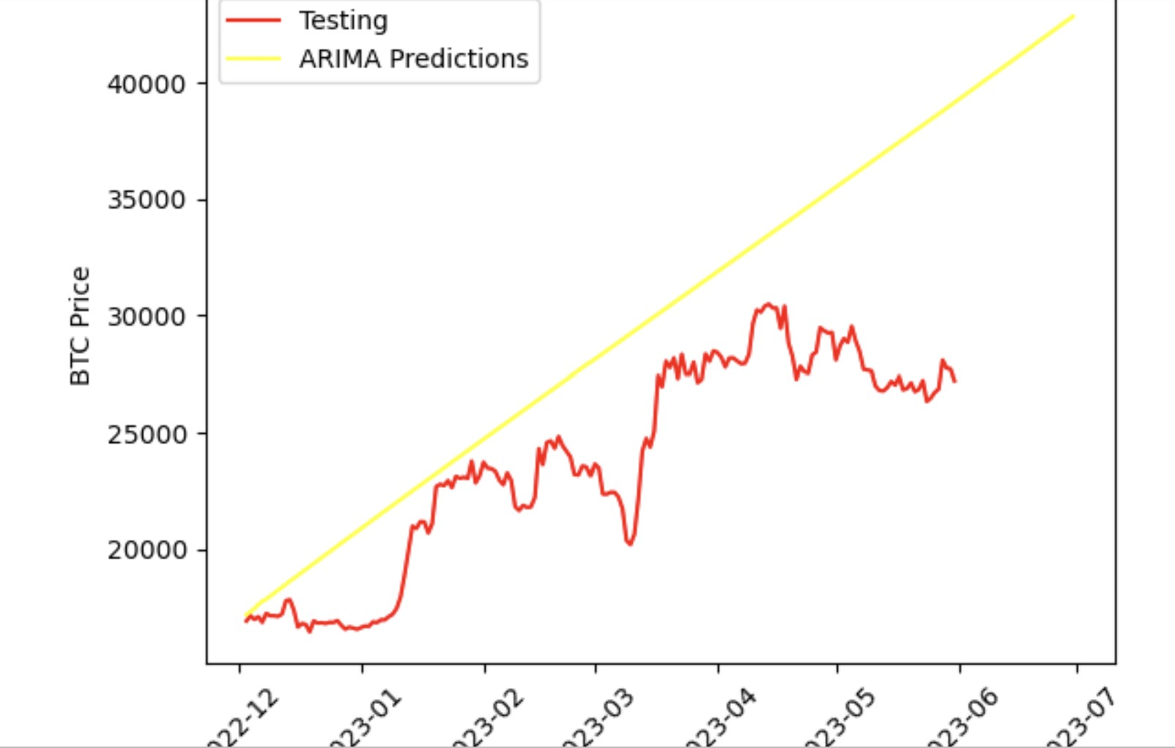

Slide 13
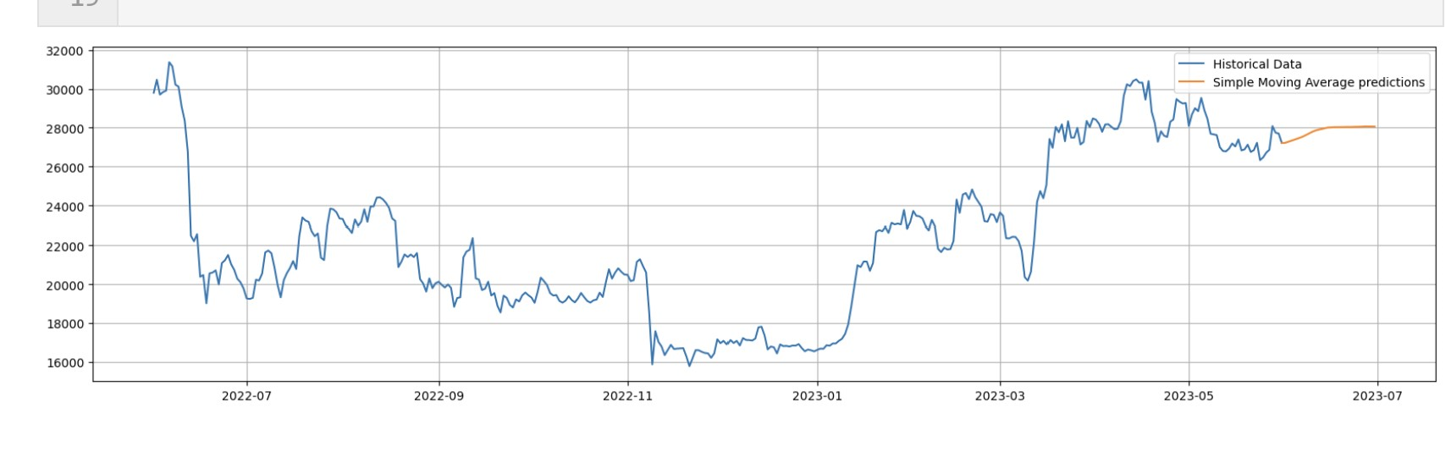

Slide 14
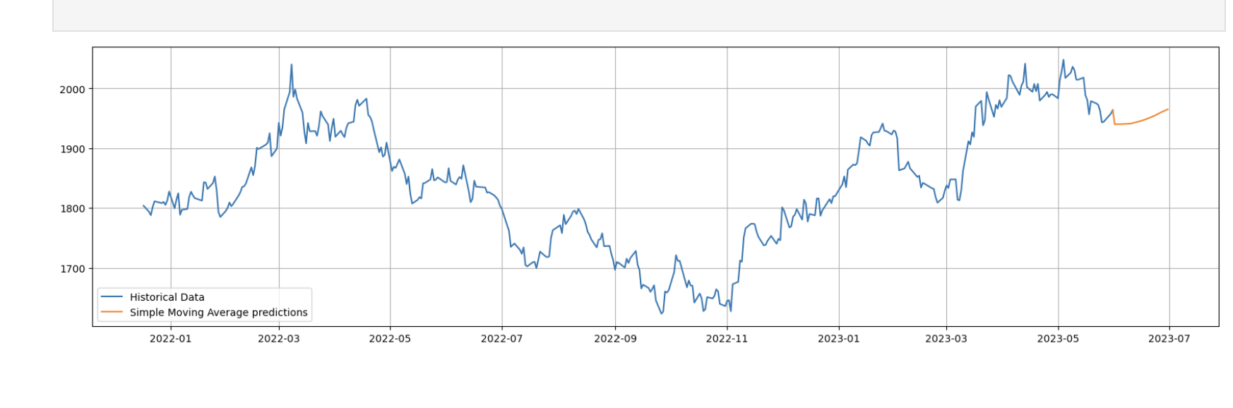

Slide 15
BTC Trading Algorithm/Backtesting analysis
Based on y_pred_df combined with historical prices from BTC_df a new data frame was produced to track past and future possible entry exit points.
Using SMA 50 and SMA 100 rolling windows seemed to be the optimal choice as adjusting these time frames yielded trends that did not accurately track pricing data from prior closing prices - the variance meant it would be tough to use shorter time frames to predict future closing prices (slide 12).
Based on the given parameters, there seemed to be no entry or exit points for future prediction of closing prices 30 days out.
If this time frame was extended further there would be a higher chance for the intersection of SMA 50 and SMA 100 that would signal a buy or sell opportunity.
However, the accuracy for which that model would hold would need to be sufficiently tested
Back Testing corroborates our findings to not exit the market - simply holding the position as of January 24, 2023 (latest entry point) would yield a favorable result - the portfolio value as of that date was close to 2.39 million and as of June 30th, 2023 spiked to nearly 4.37 million (slide 13).

Slide 16
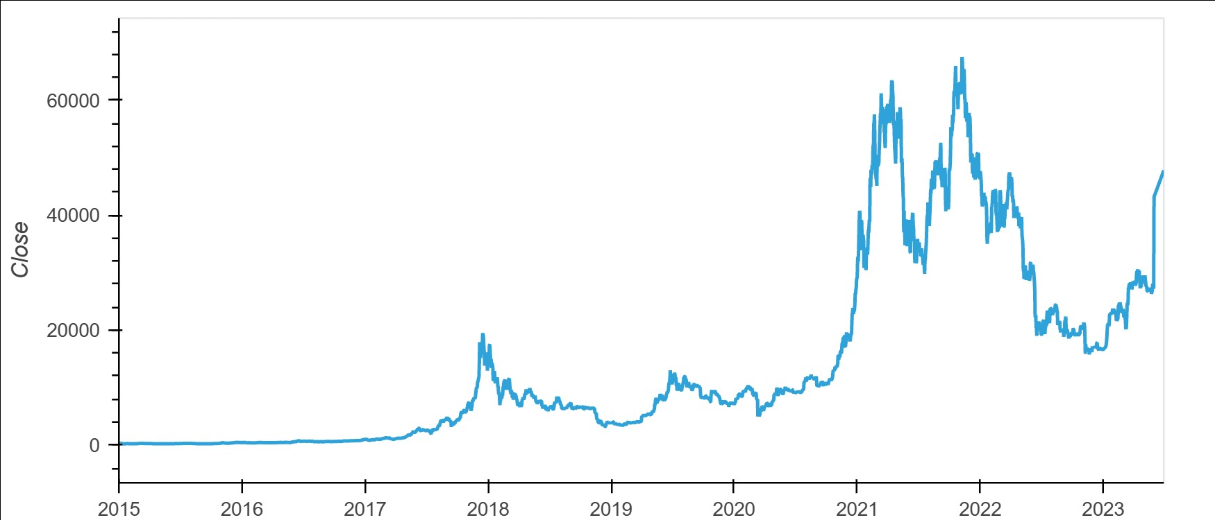

Slide 17
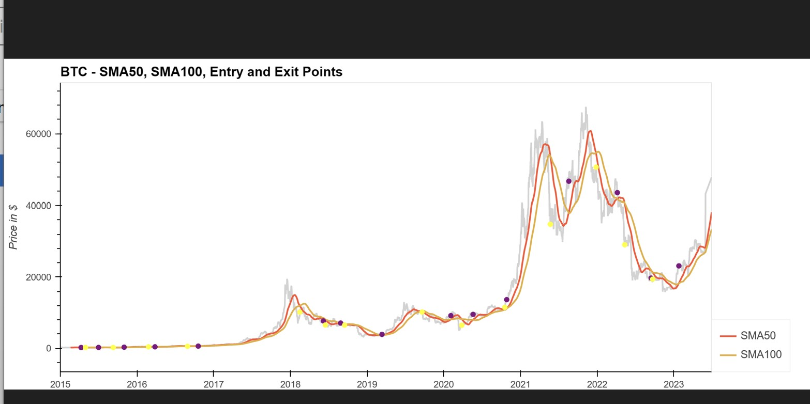

Slide 18
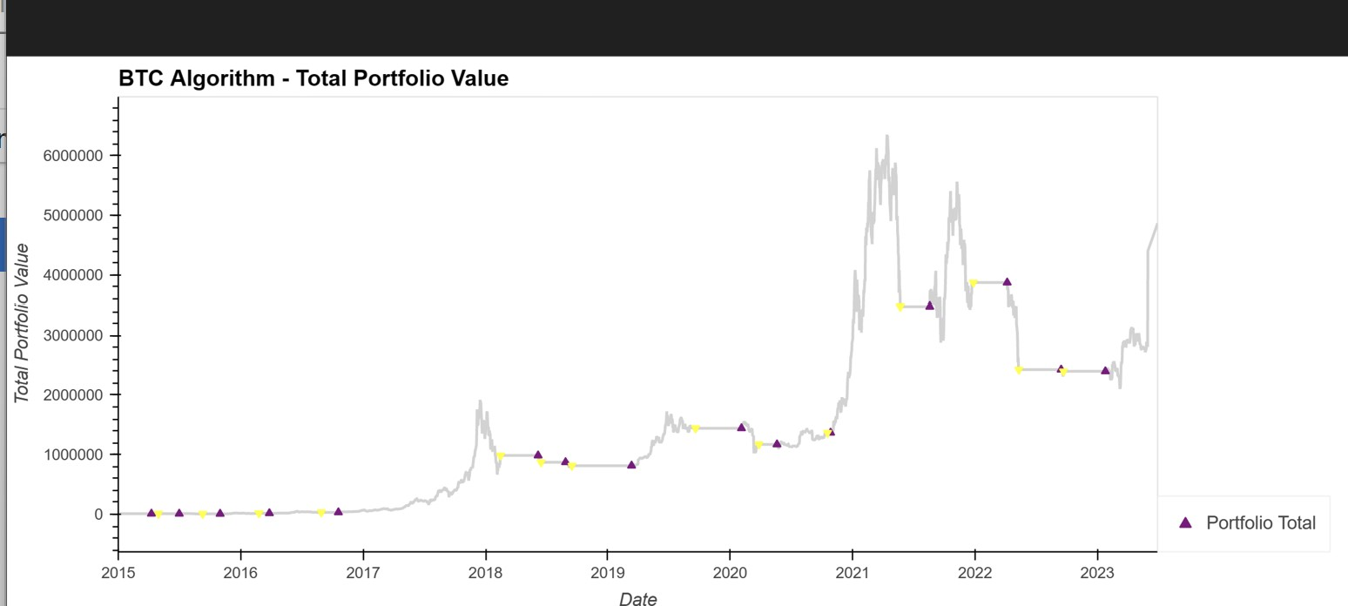

Slide 19
Gold Trading Algorithm/Backtesting analysis
The predictions data frame from simple moving averages trend analysis was combined with historical prices of Gold obtained from Yahoo Finance was produced to track past and future possible entry exit points.
ARIMA model for future closing prices was not compatible with Gold Trading Algorithm, another model needed to be used
To optimize these results, daily return prices would need to be tracked as opposed to just closing prices
Same rolling windows were used as in BTC in order to simulate historical volatility of Gold prices
Based on the trading algorithm for Gold, there seems to be no entry/exit points in the testing periods
Backtesting of gold trading algorithm seems to somewhat corroborate our findings to not enter the market post 2/1/23 and to enter the Gold market back in 5/04/23
Post 5/04/2023 backtesting does not seem to align with the true values from trading algorithm.
Adjusting dataframe or using a different predictions dataframe would yield more accurate results.
We hypothesize that the entry point of 5/04/2023 is correct and that the portfolio value would increase based on historical gold prices.

Slide 20
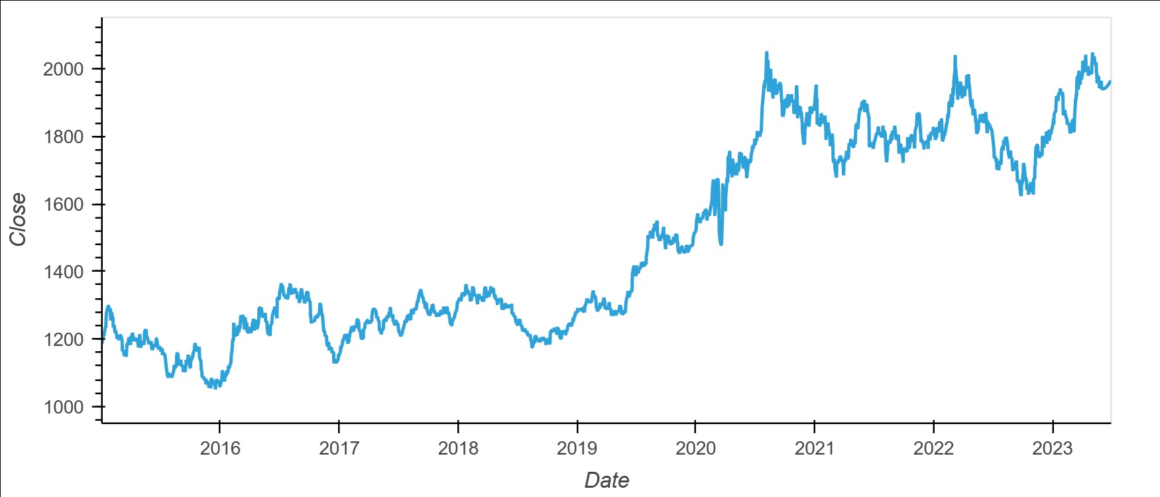

Slide 21
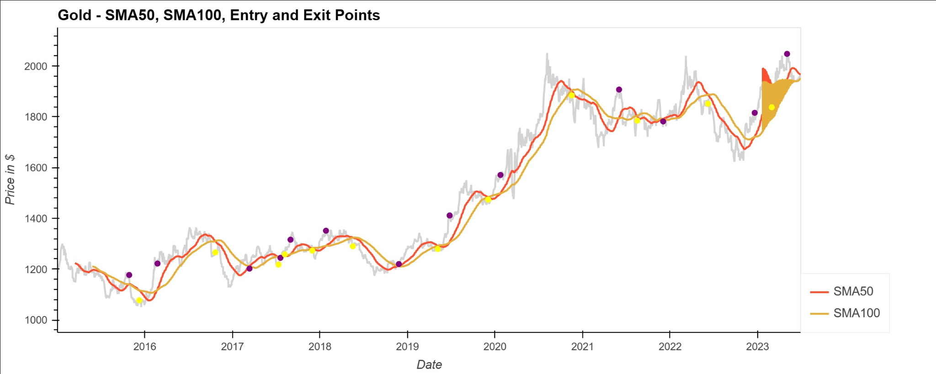

Slide 22
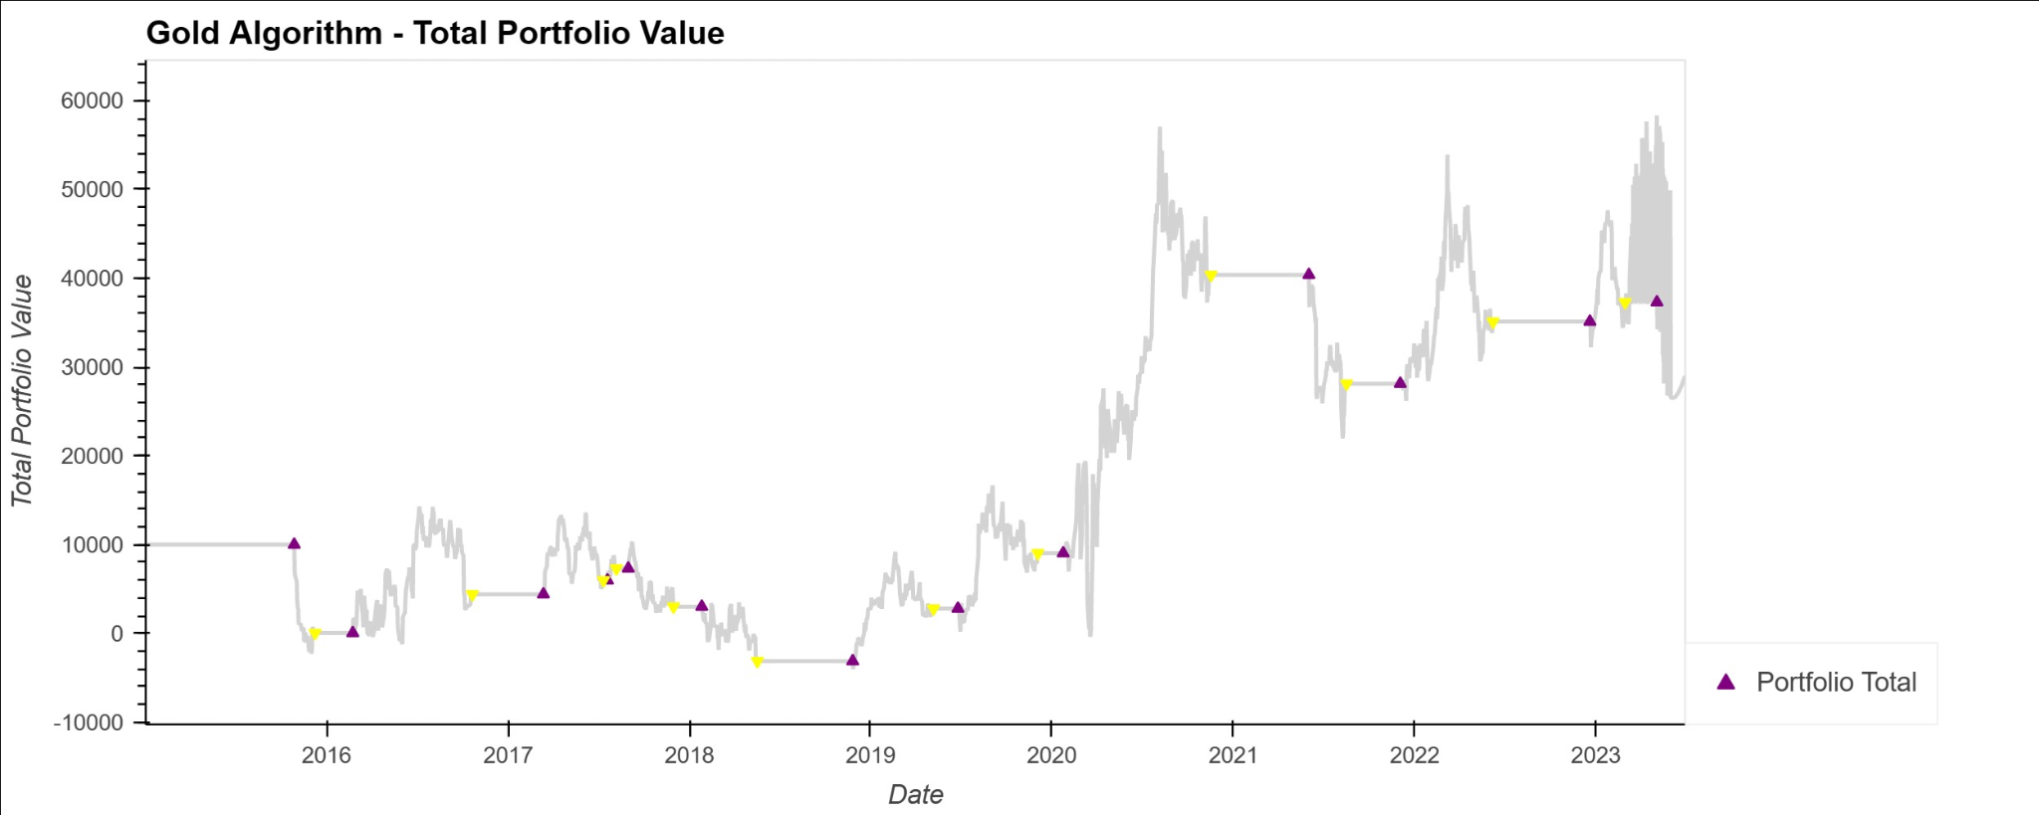

Slide 23
Conclusion:
Extend this model out further and test model using various ML techniques
Based on results no entry/exit points for testing data
Given a portfolio value starting in 2015, there would be greater potential for returns with Bitcoin.
Historically there have been only a few instances where an entry point in BTC would indicate an exit point in Gold or vice versa. Though these assets are uncorrelated these exit and entry points are not a 1:1 tradeoff - timing the market would be difficult.
Further examination of other asset classes compared to BTC would make for better risk mitigation.

